Slide 1

Visualizing Chicago Crime Reports
For the Year 2020

Slide 2
Team Members
Arnaz Alavi
Junaid Dawood
Ratika Chauhan
Ratna Jadhav
Seong-Min Kim

Slide 3
Purpose
As this Bootcamp has taught us, the best way to see, understand, and analyze data would be to deploy visualizations. Creating an interactive interface displaying the data in various forms helps tell a story.
As residents of Chicago, we found it fitting to create an interactive dashboard to visualize Crime Data in our city. We wanted to provide a place for anybody to be able to click around and easily get information about crime rates in Chicago.

Slide 4









Our Coding Approach
DATA SOURCE
Web API
Chicago Police Department's CLEAR System
ETL
MongoDB
Flask
FRONT-END
D3
Java Script
HTML
CSS
Pandas

Slide 5

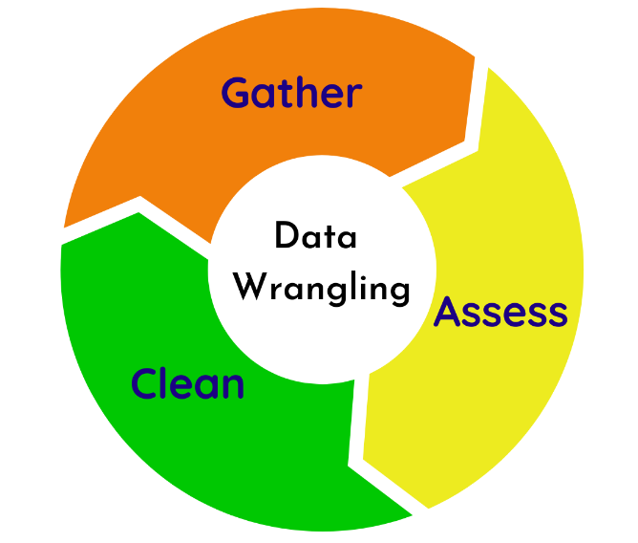



Data Wrangling

Slide 6
Chicago Crime Map Limitation & Challenge’s
Goejson format -> "features": [{"type":"Feature","geometry":{"type":"Point","coordinates":[-87.727999591,41.967287545]},"properties":
Data Loaded to MongoDB ->{'type': 'Feature',
'geometry': {'type': 'Point', 'coordinates': [-87.561272312, 41.764728045]},
'properties': {'location_state': ‘’,
Example app.py script:
cursor= mongo.db.events.find({ '$and': [{'properties.year': '2020'}, {'properties.primary_type': selector}] })
features=[]
for geojson_feature in cursor:
features.append({
"type": geojson_feature['type'],
"geometry": geojson_feature['geometry'],
"properties" : geojson_feature['properties']
}
)
#print(features)
data = { 'features' : features}
Source of API (Geojson)
Geojson format with Leaflet used to draw the map
Geojson data has “features” array/list that make is easy to plot the map.
Data Format issue : Data was not fully loaded as geojson format because some other challenges. The features list was missing. A line was added to a python script to convert data fully to a geojson format after the for loop.
data = { 'features' : features}
Performance issue : Data Extraction is limited to only three prime types using a query python script
mongo.db.events.find({ '$and': [{'properties.year': '2020’}, {'properties.primary_type': selector}] })
Data from MongoDB passed to a map JavaScript using Jinja and flask application.
Notes:
Goejson format -> "features": [{"type":"Feature","geometry":{"type":"Point","coordinates":[-87.727999591,41.967287545]},"properties":
Data Loaded to MongoDB ->{'type': 'Feature',
'geometry': {'type': 'Point', 'coordinates': [-87.561272312, 41.764728045]},
'properties': {'location_state': ‘’,
Example app.py script:
cursor= mongo.db.events.find({ '$and': [{'properties.year': '2020'}, {'properties.primary_type': selector}] })
features=[]
for geojson_feature in cursor:
features.append({
"type": geojson_feature['type'],
"geometry": geojson_feature['geometry'],
"properties" : geojson_feature['properties']
}
)
#print(features)
data = { 'features' : features}

Slide 7
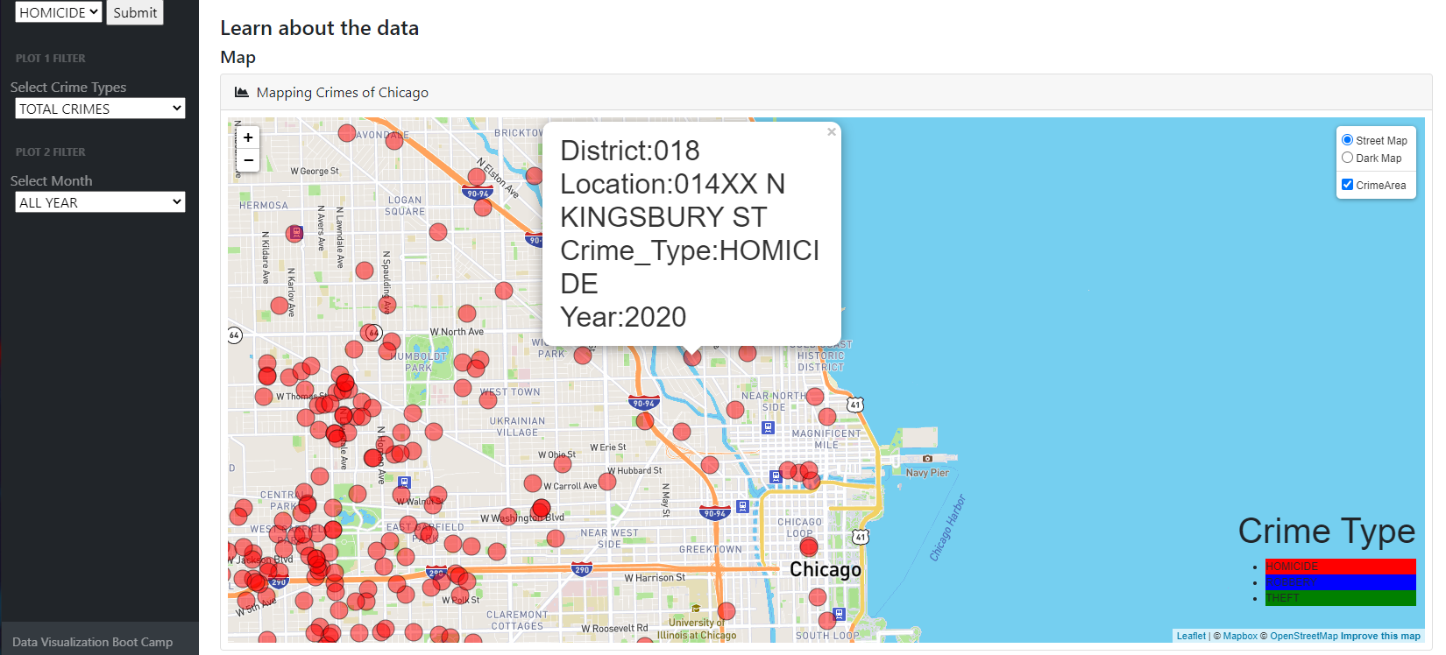
Geo-Map
(Will be covered during Live Demo)
A selector to pick from three crime types.
Two Base layers: Using streetmap tile layer and darkmap tile layer .Visible at a time.
A Overlay layer: Go over the base layer and can be turn off and on.
Circle markers to display the location of the crimes. The crime types are distinguish by colors.

Slide 8
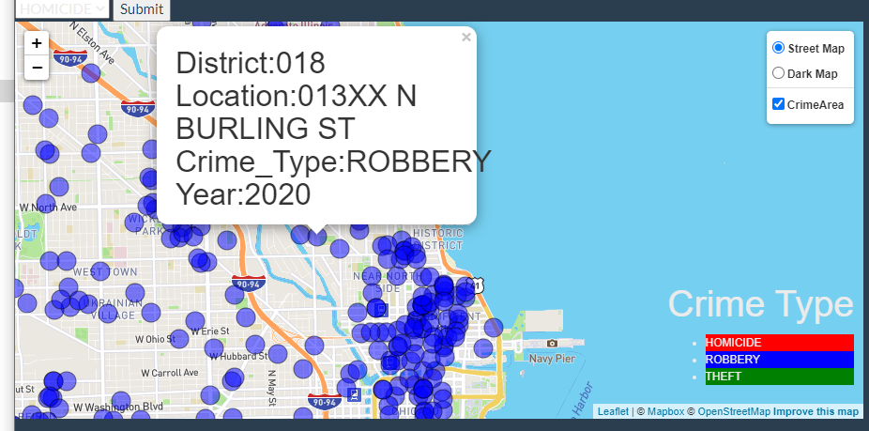
Geo-Map (cont.)
(Will be covered during Live Demo)
For crime type Robbery, set the circle to blue.
For crime type Robbery, set the circle to blue.
For crime type Robbery, set the circle to blue.
When a marker is clicked, a popup appears to display district , location, crime type and year.

Slide 9
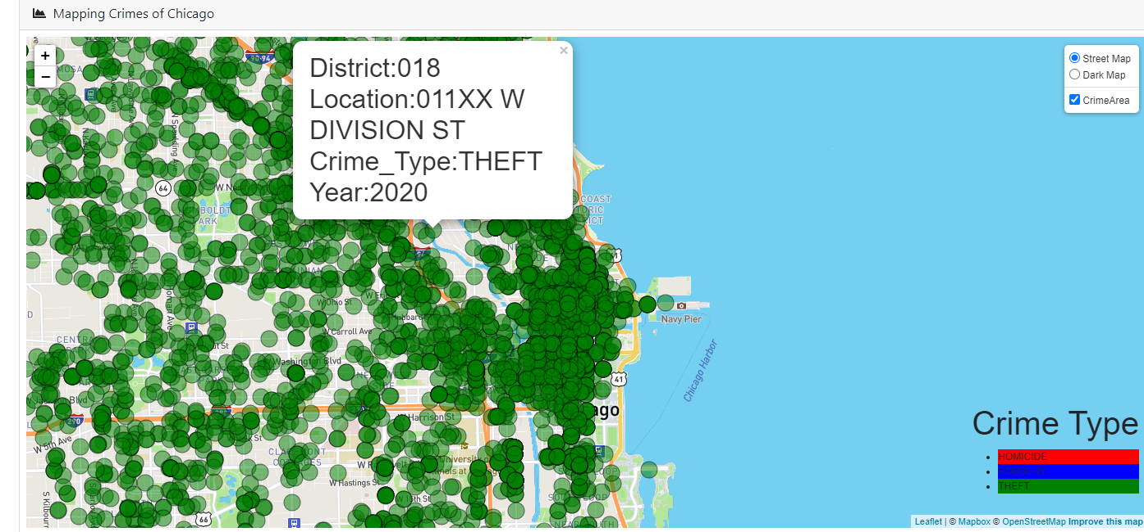
Geo-Map (cont.)
(Will be covered during Live Demo)
Mouse over on a circle marker highlight the circle marker
Mouse out change back the circle marker un highlighted.
Three crime labels represented at the bottom of the map.

Slide 10
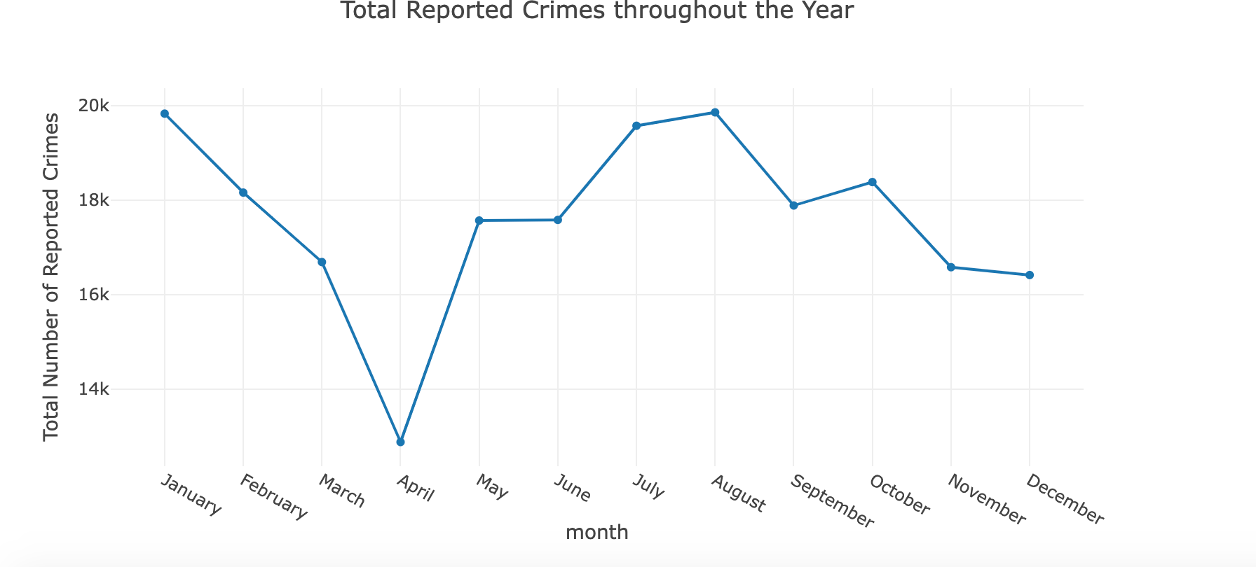
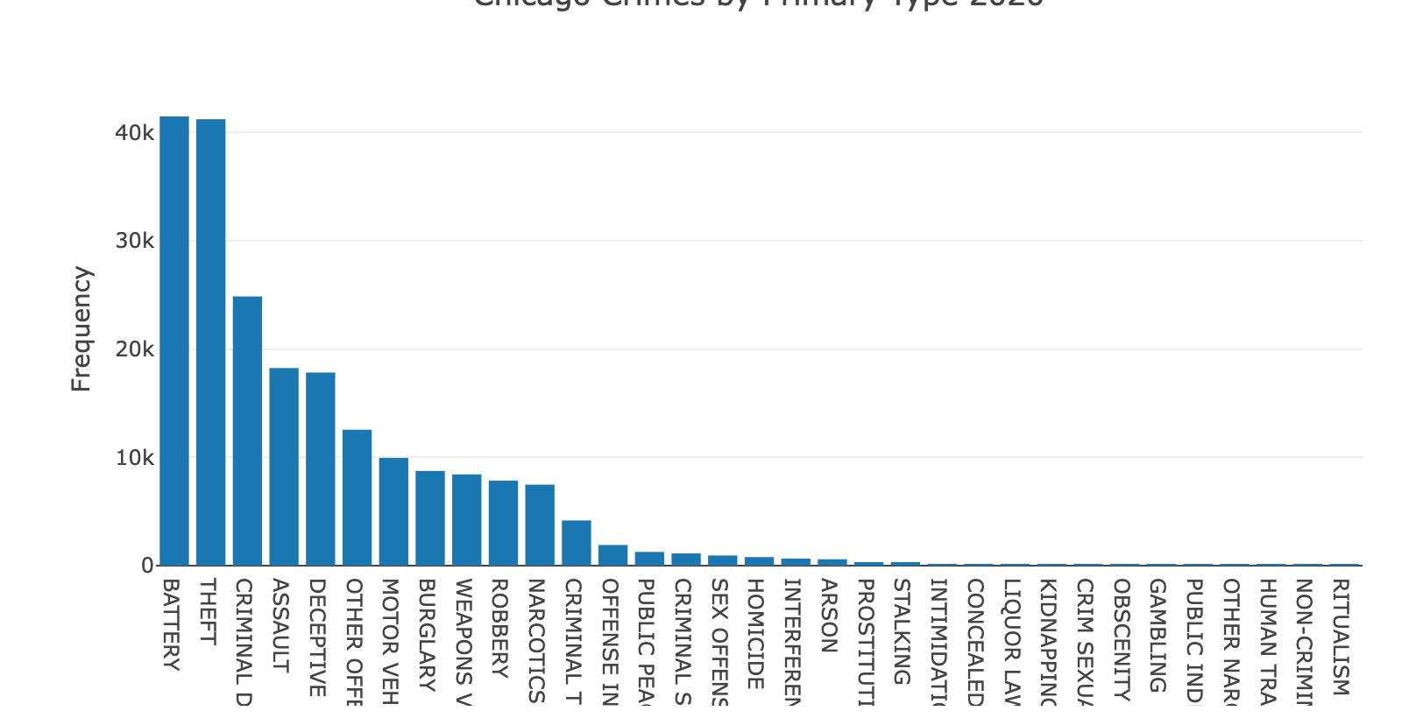
Plots
2 interactive charts made with Plotly
Plot 1: Number of crime reports through the year
Filter by crime types
Plot 2: Number that each crime types was reported
Filter by the month

Slide 11
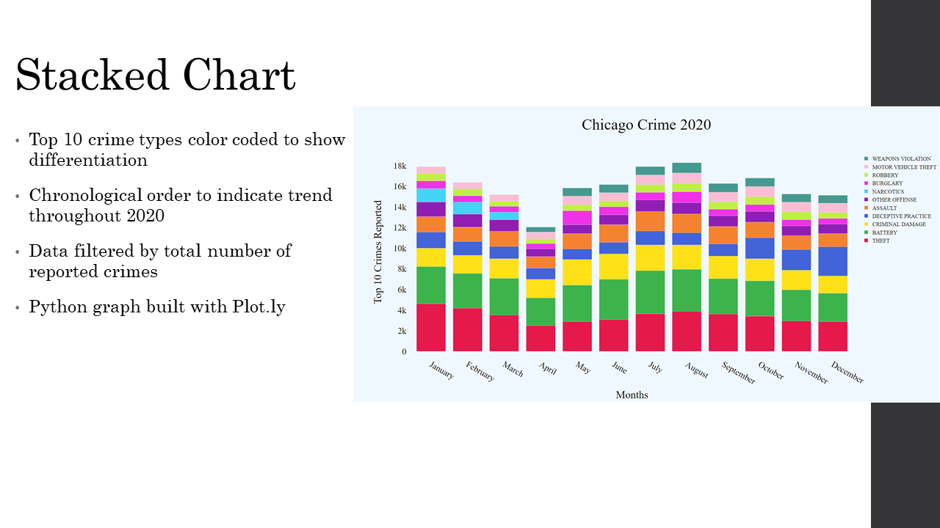

Slide 12

Let’s see it in action!
LIVE DEMO

Slide 13
Next Steps
Use a cloud-shared database
Deploy our code into Heroku Cloud
Optimize our data retrieval process to include more records
Provide prompts on dashboard to encourage user to utilize the visuals
Ex: Are you interested in moving to Lakeview East? Click on the map to view the crime rate in that neighborhood.

